Slide 1
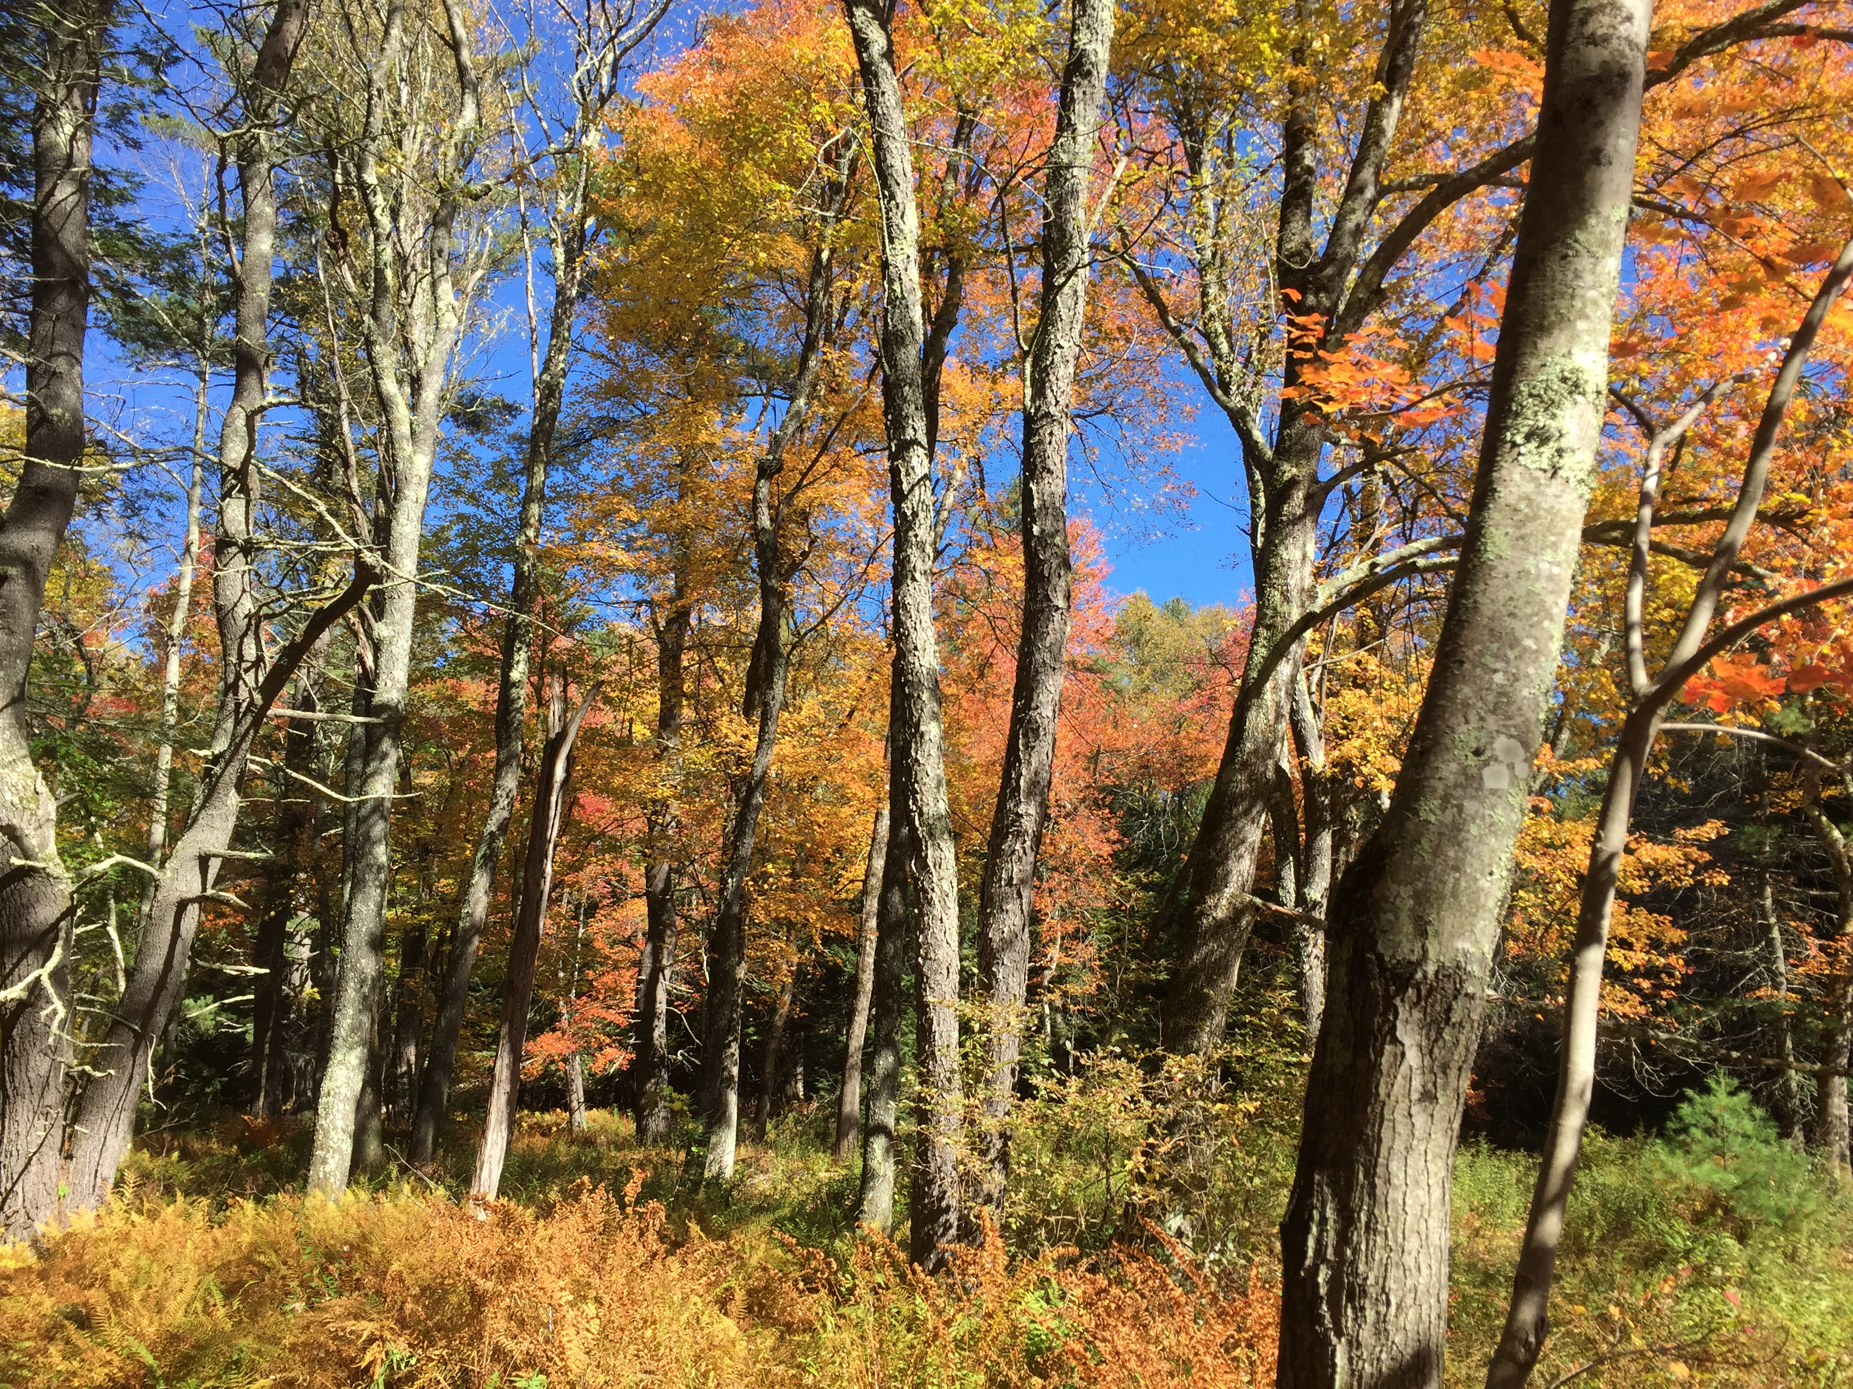
Understanding plant phenology in a warming world
Examining urban effects

Slide 2
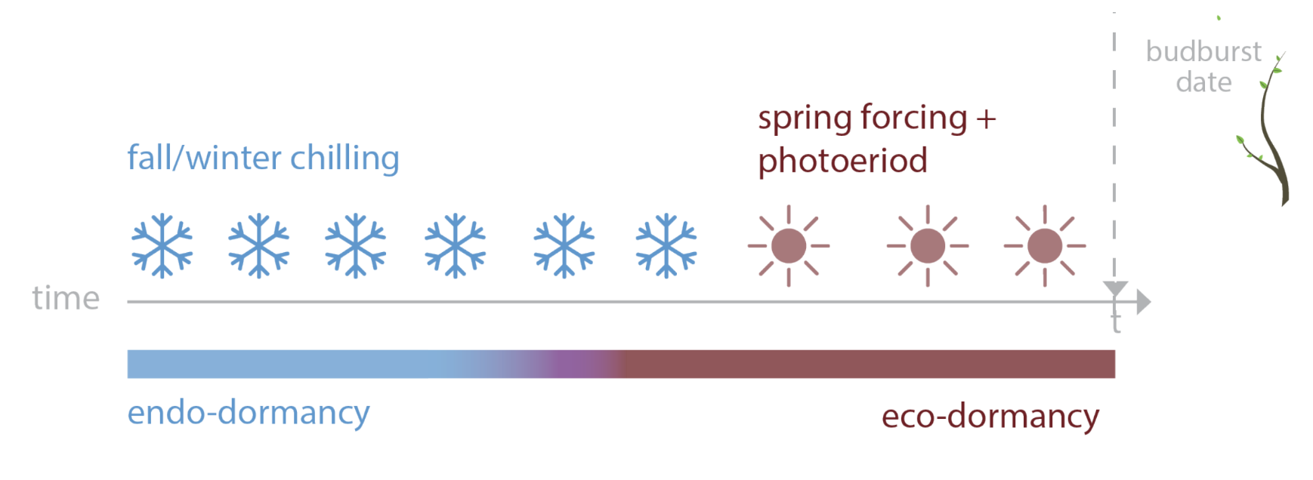
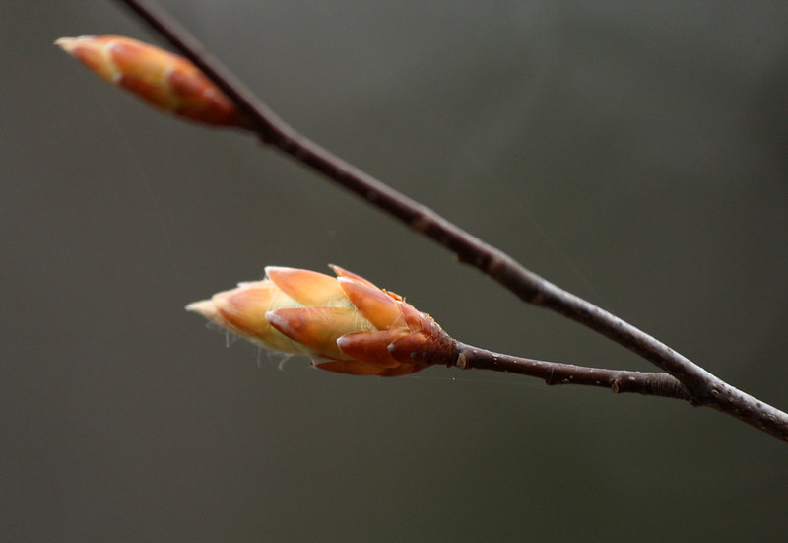
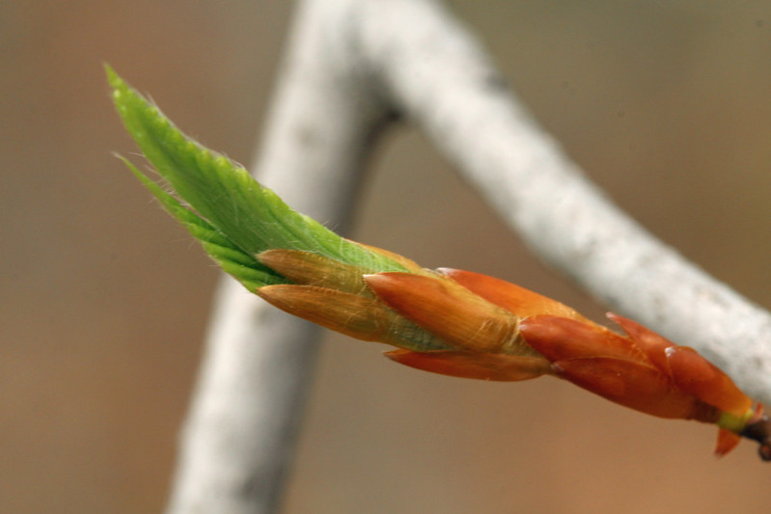
PHENOLOGY USES MULTIPLE CUES
spring warming + daylength
Ettinger, Chamberlain, et al, Nature Climate Change

Slide 3
Growing Degree Days (GDDs)
If temperature is greater than 0℃, then you add up the temperatures
X =
E.g., Temperature is...
Day 1: 5
Day 2: 7
Day 3: -2
So by Day 3, 12 GDDs (5+7) have been accumulated.
T – 0 if T>0
0 if T<=0
– 0 = 5
– 0 = 7
<= 0 so is 0

Slide 4
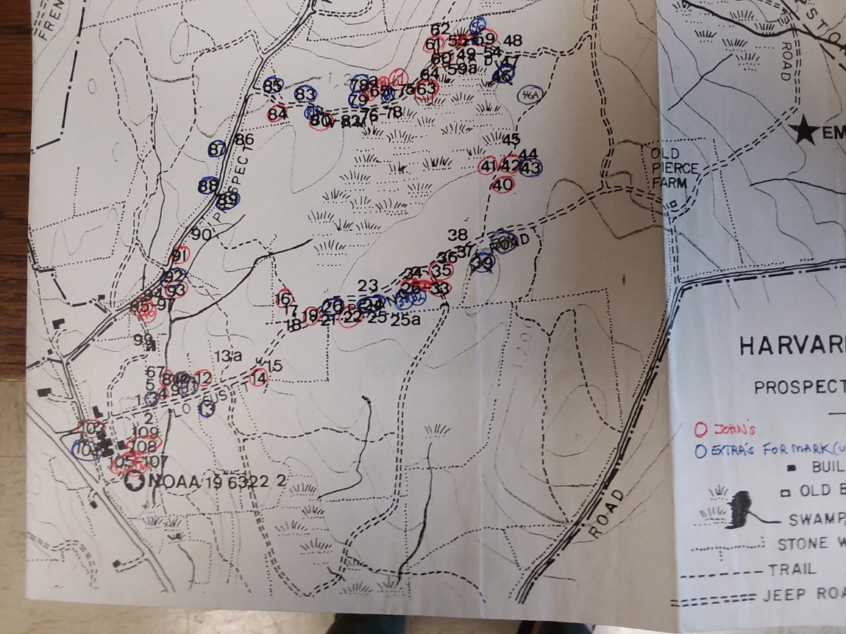

Slide 5
SITE EFFECTS

Slide 6
METHOD EFFECTS

Slide 7
INTERACTION

Slide 8
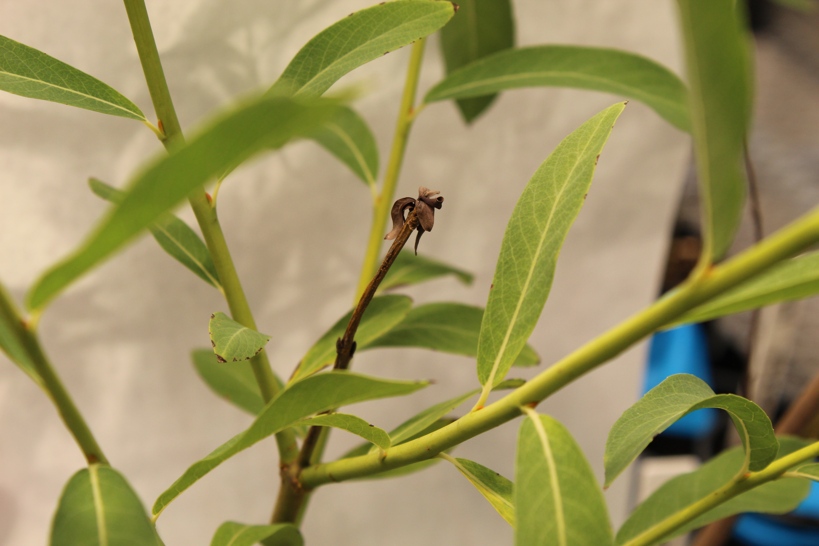
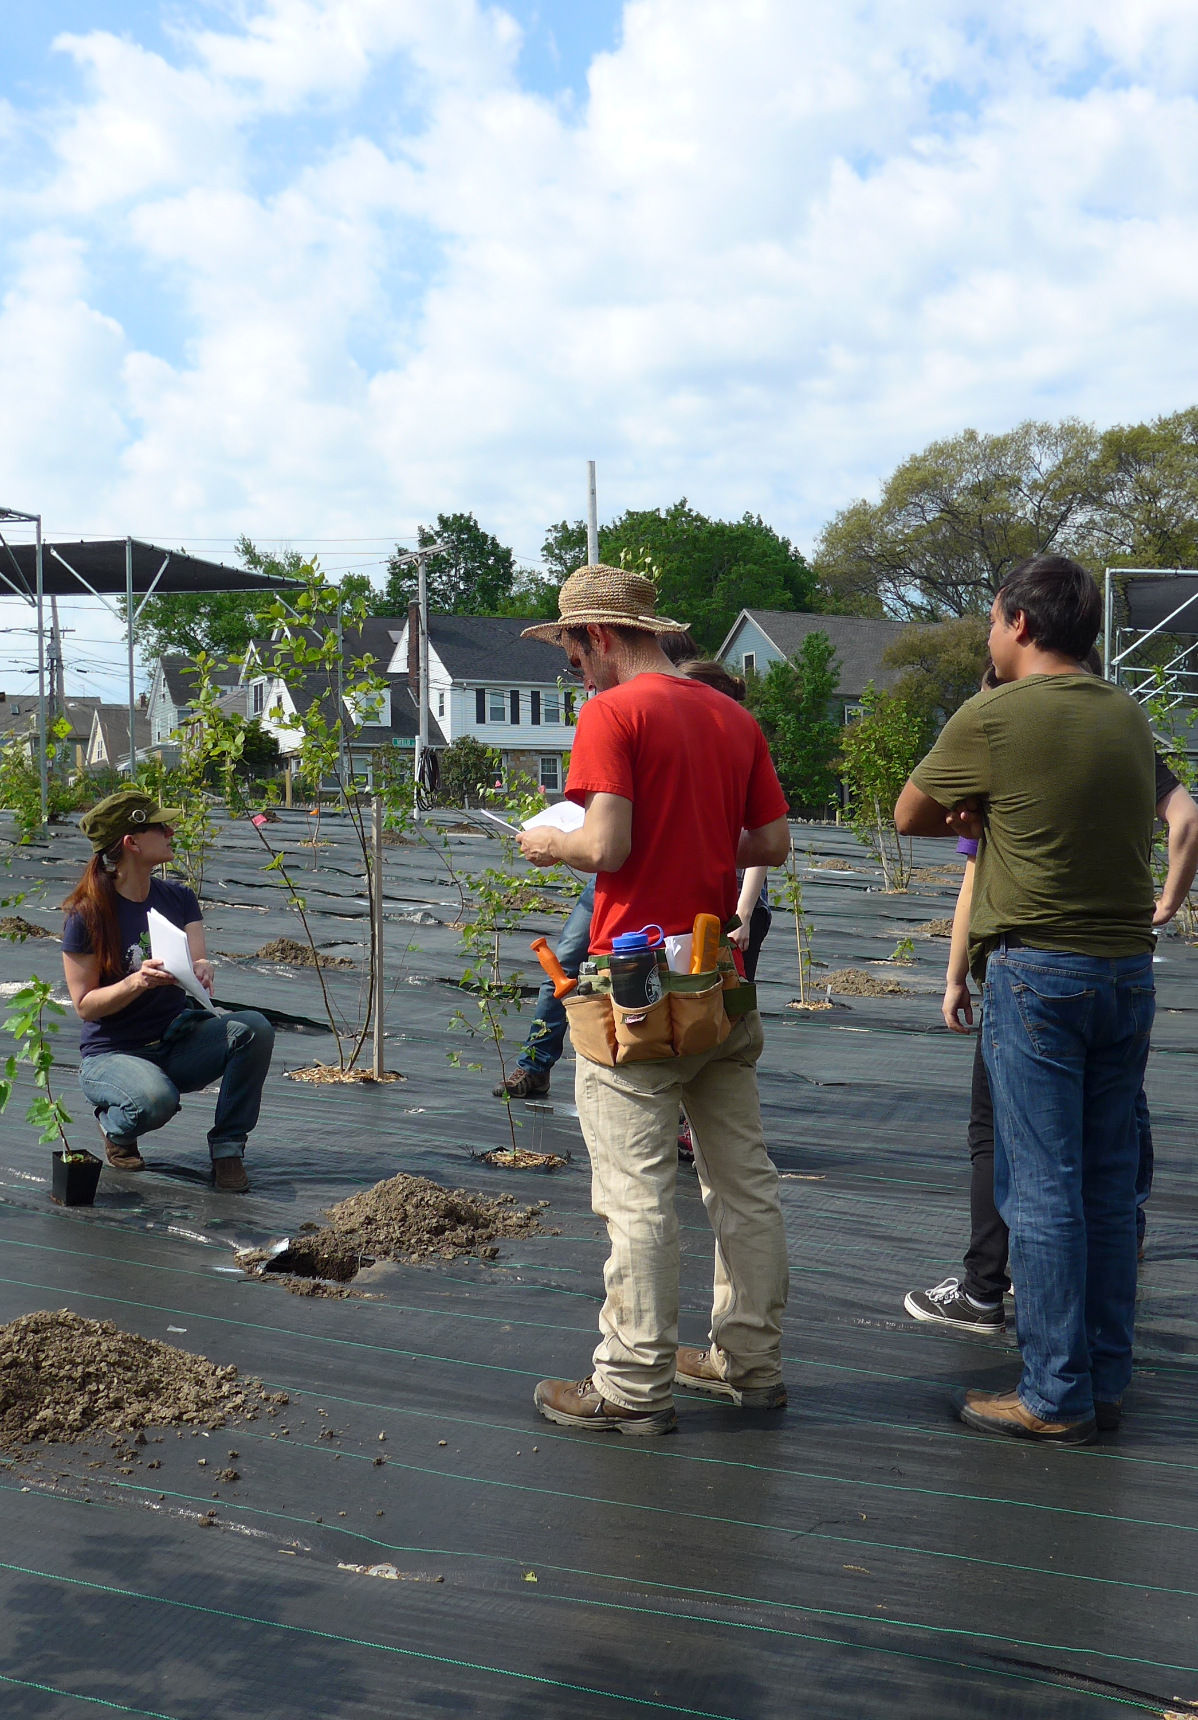
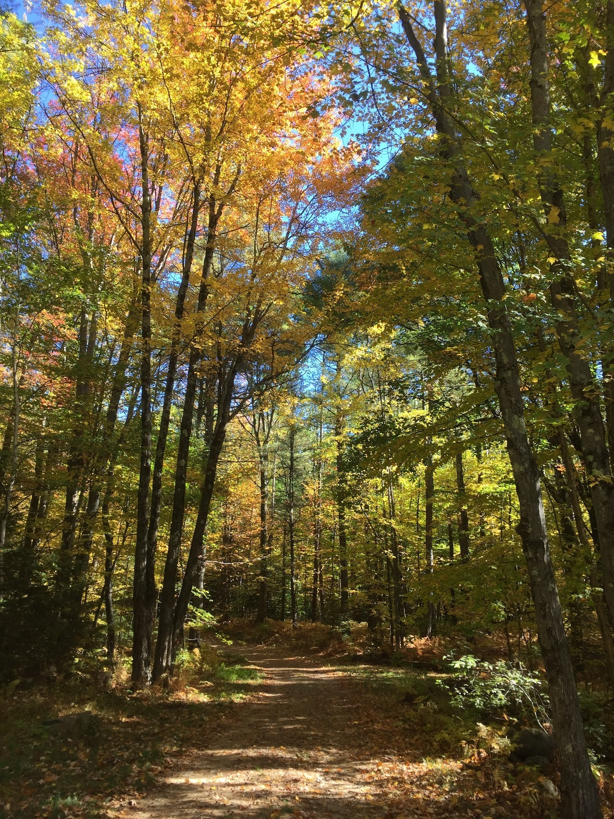
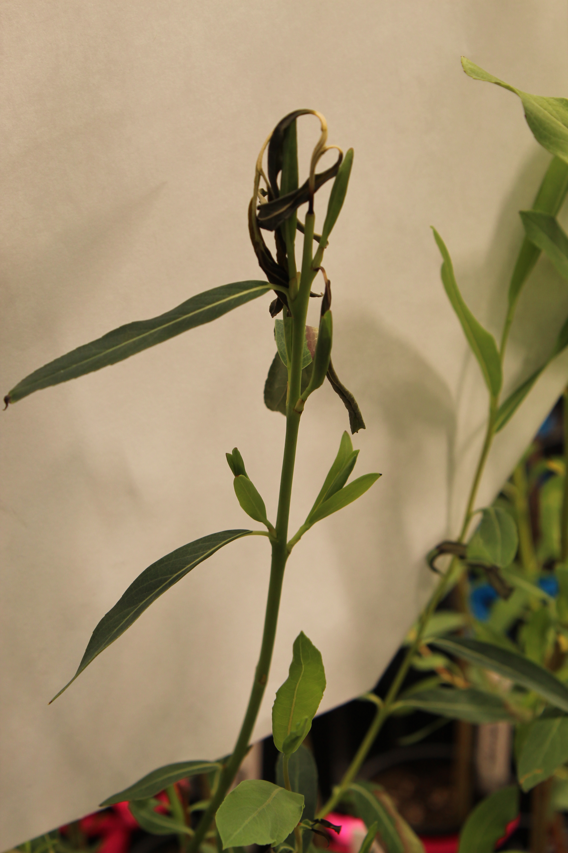
WHY IS PLANT PHENOLOGY SO IMPORTANT?
Spring Freeze Risk
Drought Risk
Growth Rate
Carbon Sinks

Slide 9
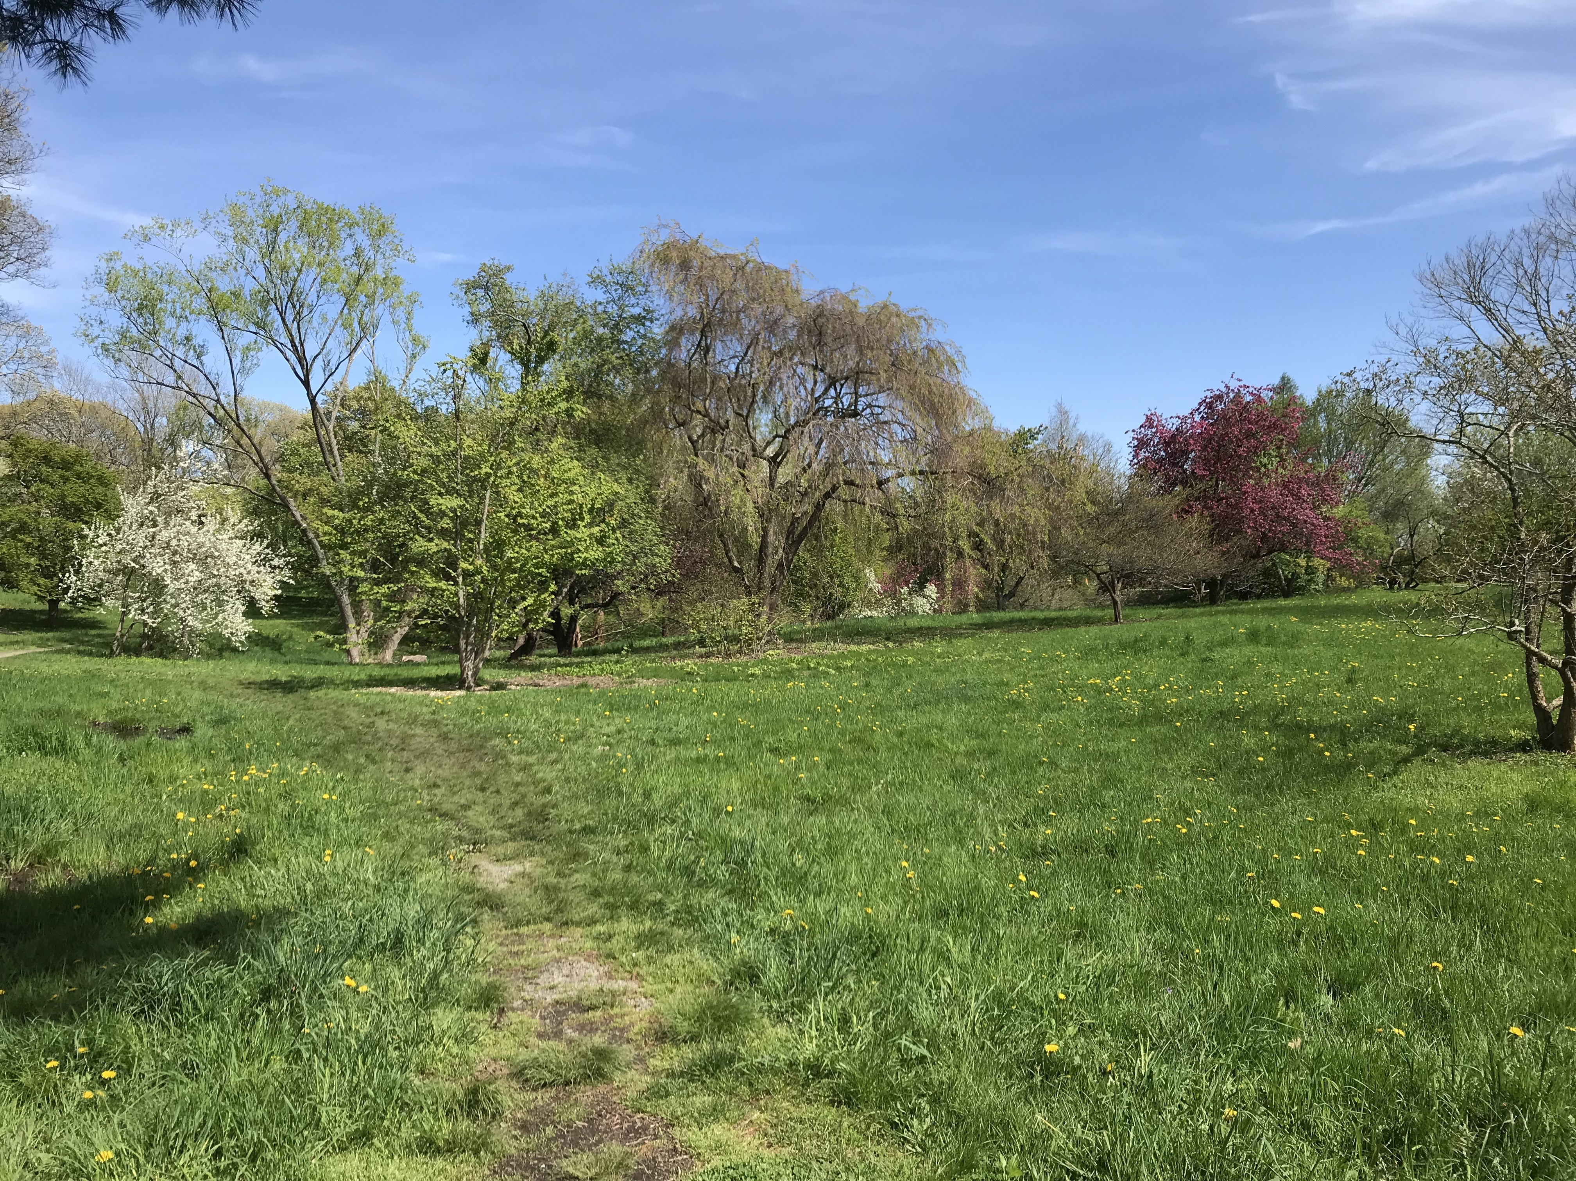
THANK YOU!

Slide 10









THE TEMPORAL ECOLOGY LAB
Lizzie Wolkovich, PhD
Dan Buonaiuto
Ignacio Morales-Castilla, PhD
Aileen Ettinger, PhD
Deirdre Loughnan
Darwin Sodhi
ARNOLD ARBORETUM - TREE SPOTTERS
Suz Mrozak
Danny Schissler
Kate Stonefoot
Pam Thompson
Our Citizen Scientists!!
COMMITTEE MEMBERS
Paul Moorcroft, PhD
Neil Pederson, PhD
COLLABORATORS AND SPECIAL THANKS
Iñaki Garcia de Cortazar-Atauri, PhD
Ben Cook, PhD
Kea Woodruff
Faye Rosin
Alice Linder
Dan Flynn
Alissandra Ayala
John O’Keefe, PhD
Audrey Barker Plotkin
THE HOLBROOK LAB
Noel Michele Holbrook, PhD
Fulton Rockwell, PhD
Jess Gersony
Anju Manandhar
Meghan Blumstein
Morgan Furze, PhD
Zhe He
Erin Wright

Slide 11
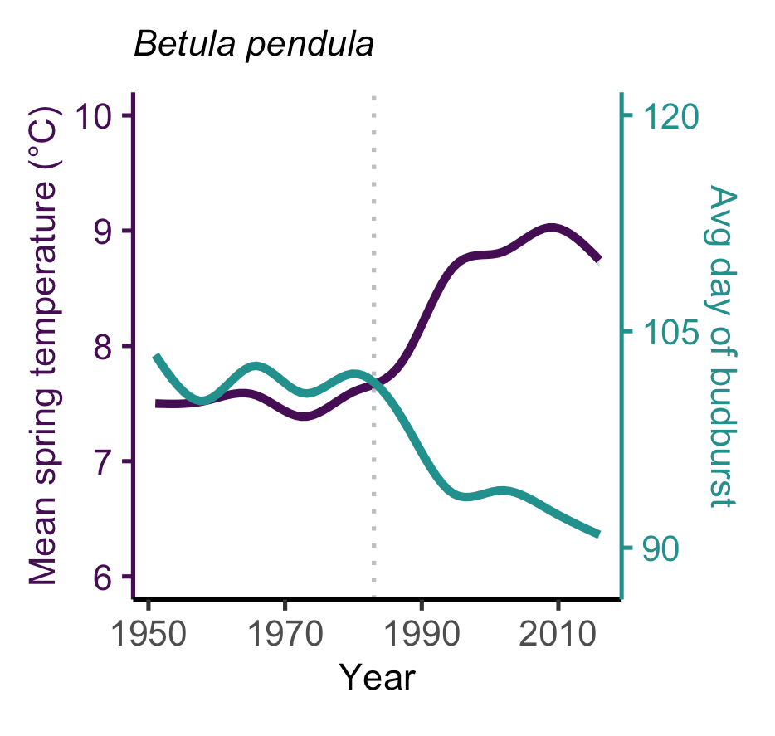
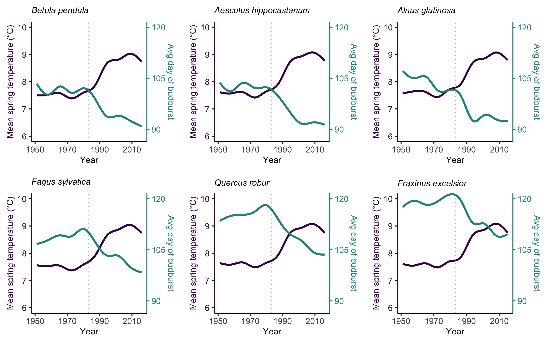
PHENOLOGY IS ADVANCING
Chamberlain et al, New Phytologist

Slide 12
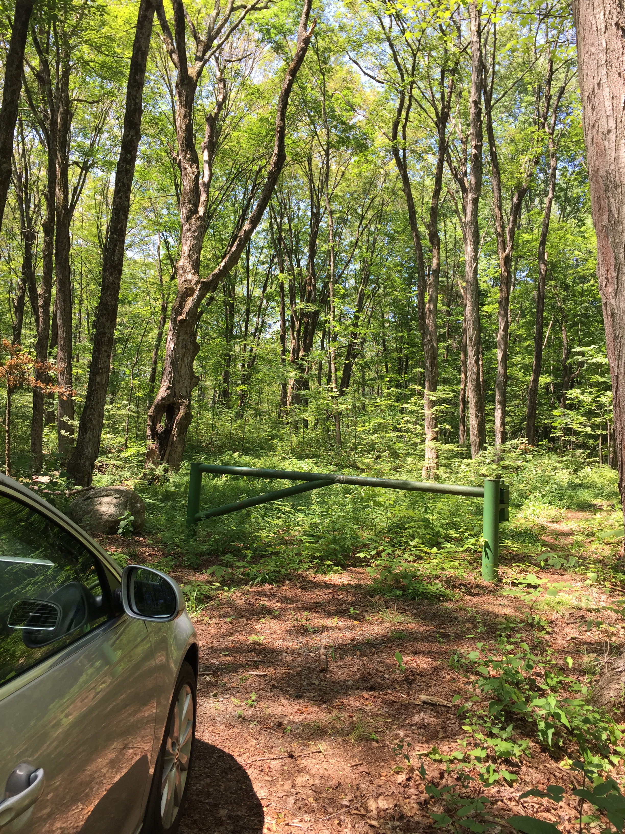
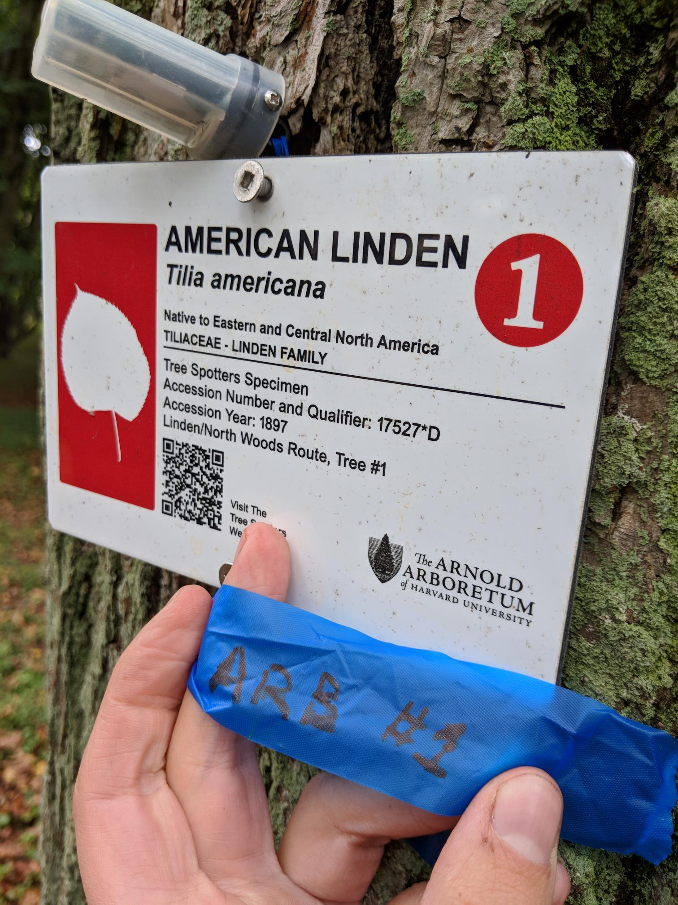
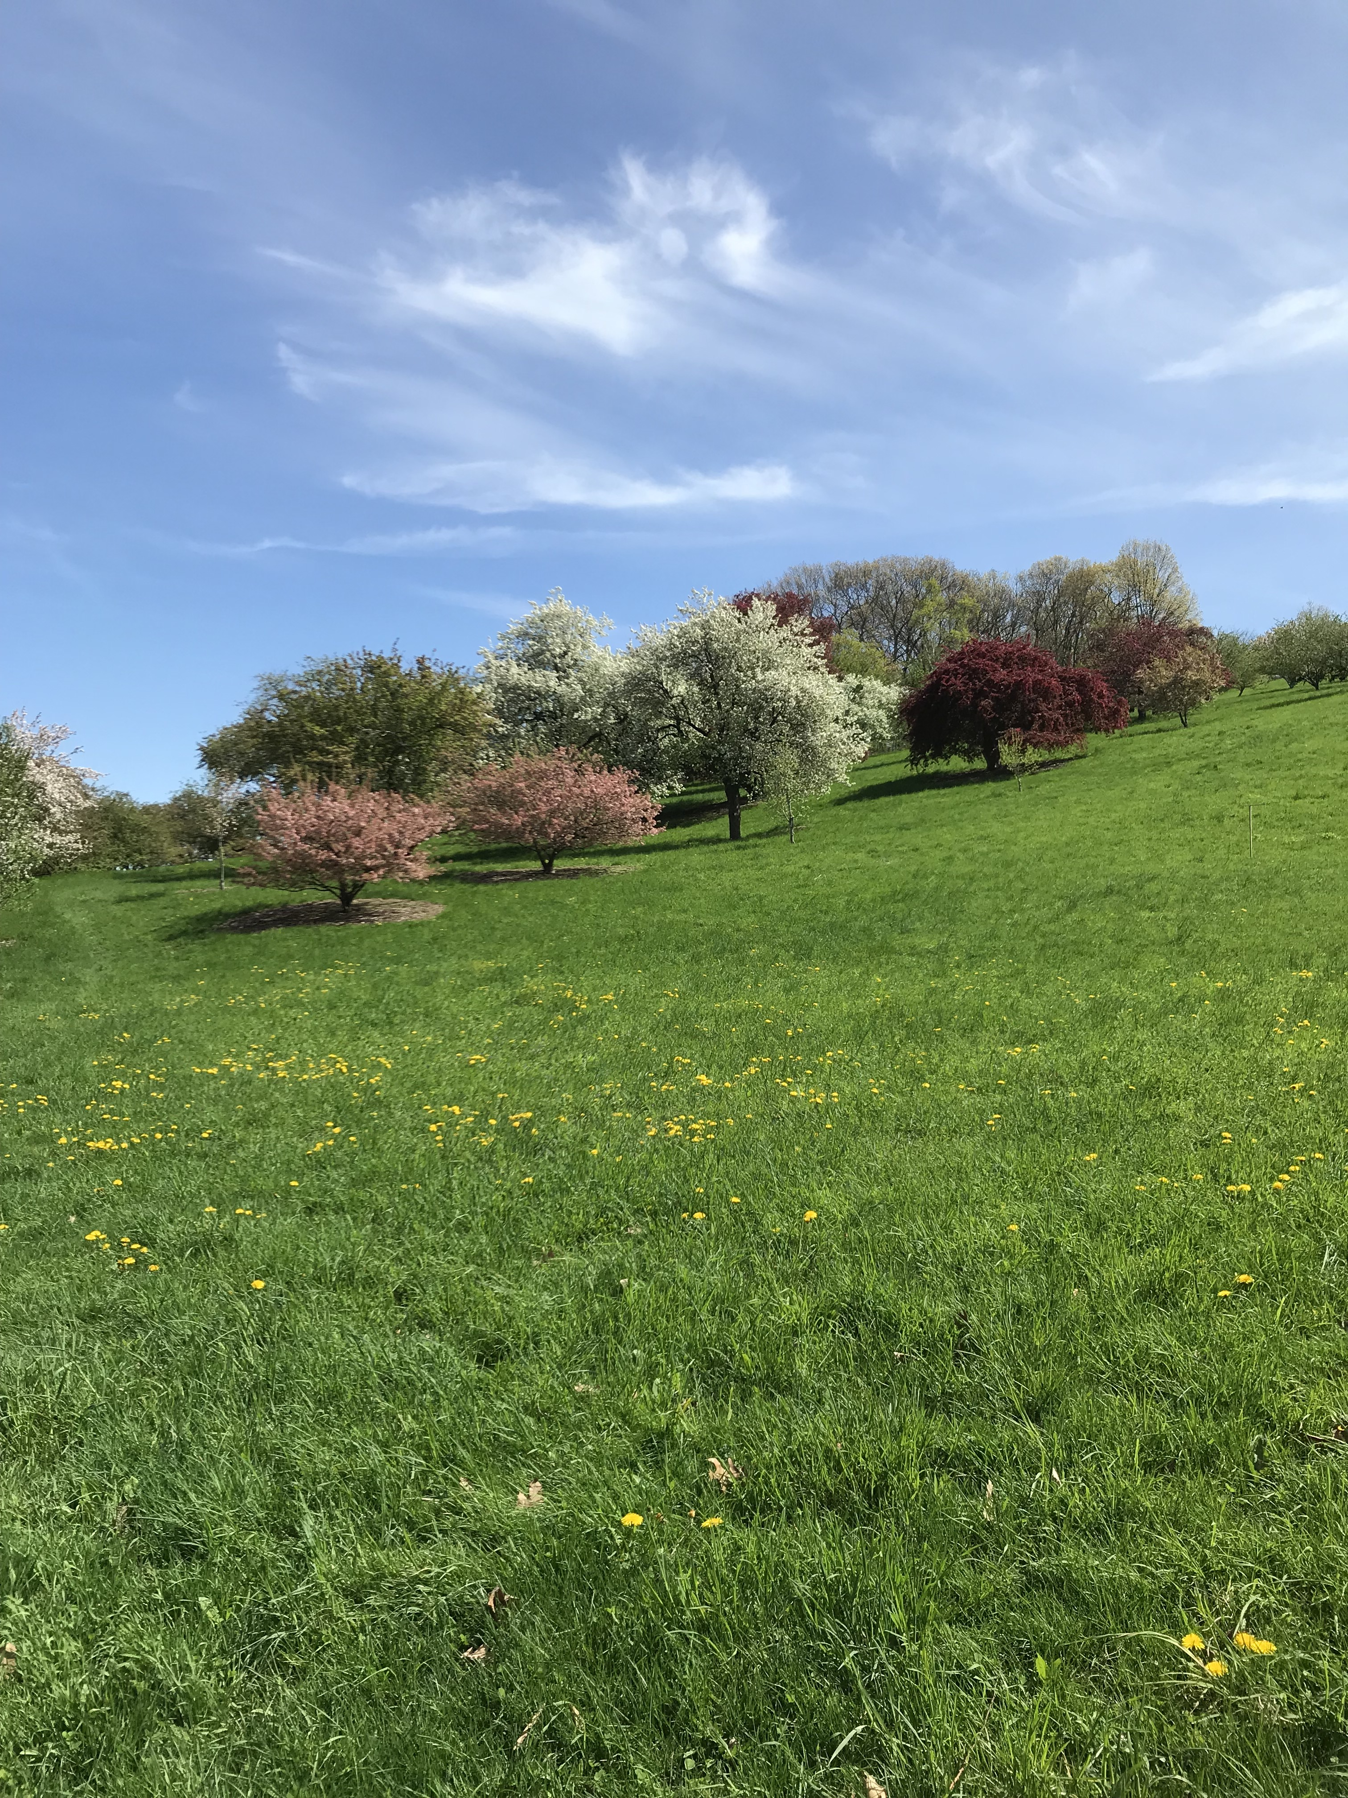
QUICK CONCLUSIONS
GDDs VARY ACROSS SITES
Harvard Forest has more GDDS
GDDS DIFFER BETWEEN METHODS
Hobo loggers record higher GDDS
BUT! We have an interaction
More variation in GDDs at the Arboretum
PHENOLOGY IS FINICKY. More work to be done!

Slide 13
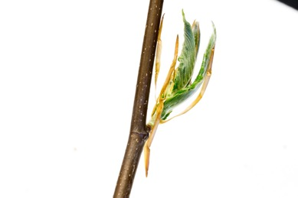
SITE EFFECT
Arboretum
Fagus grandifolia
Harvard Forest
Jan 1
Dec 31

Slide 14
SITE EFFECT
Arboretum
Fagus grandifolia
Harvard Forest
Jan 1
Dec 31

Slide 15
METHOD EFFECT
Hobo Logger
Fagus grandifolia
Weather Station
Jan 1
Dec 31

Slide 16
METHOD EFFECT
Hobo Logger
Fagus grandifolia
Weather Station
Jan 1
Dec 31

Slide 17
Budburst to leafout
Harvard Forest
Arnold Arboretum

Slide 19
Breakdown of weather data
ARBORETUM
HARVARD FOREST

